Slide 1
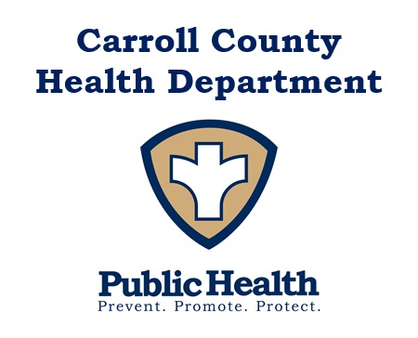
Ed Singer, L.E.H.S. Carroll County Health Officer *Please note that this data is preliminary and subject to change.
Carroll County
Board of Education
COVID-19 Data Update
August 11, 2021

Slide 2
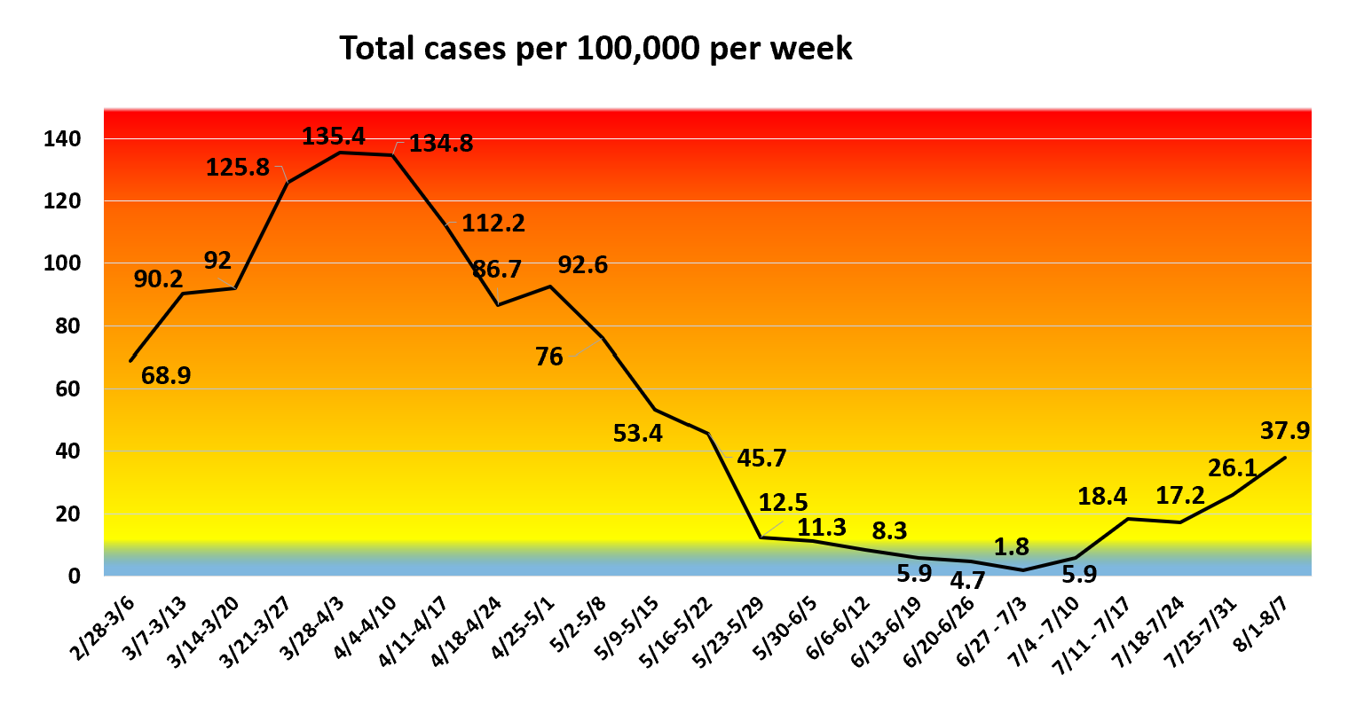
Levels of community transmission as defined by the CDC: - Total new cases per 100,000 in past 7 days: low 0-9.99, moderate 10-49.99, substantial 50-99.99, high >= 100 - Percent positive tests in past 7 days: low 0-4.99%, moderate 5-7.99%, substantial 8-9.99%, high >=10% - If the two indicators suggest different transmission levels, the higher level is selected.
Total new cases per 100,000 this week:
37.9, moderate
Up +11.8 from last week
Positivity rate in Carroll County:
3.45%
Low
Up +2.01% from last week

Slide 3
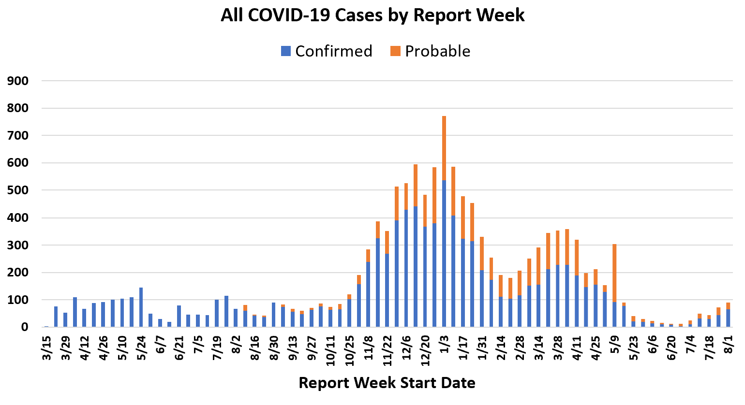
Probable cases
Probable cases are those who test positive with an antigen test, not a PCR test.
Probable cases are not included in our confirmed case totals (PCR test only).
Cases that are confirmed with PCR tests are removed from the probable totals.
Week of 5/9 high due to lab submitting multiple weeks of past reports

Slide 4
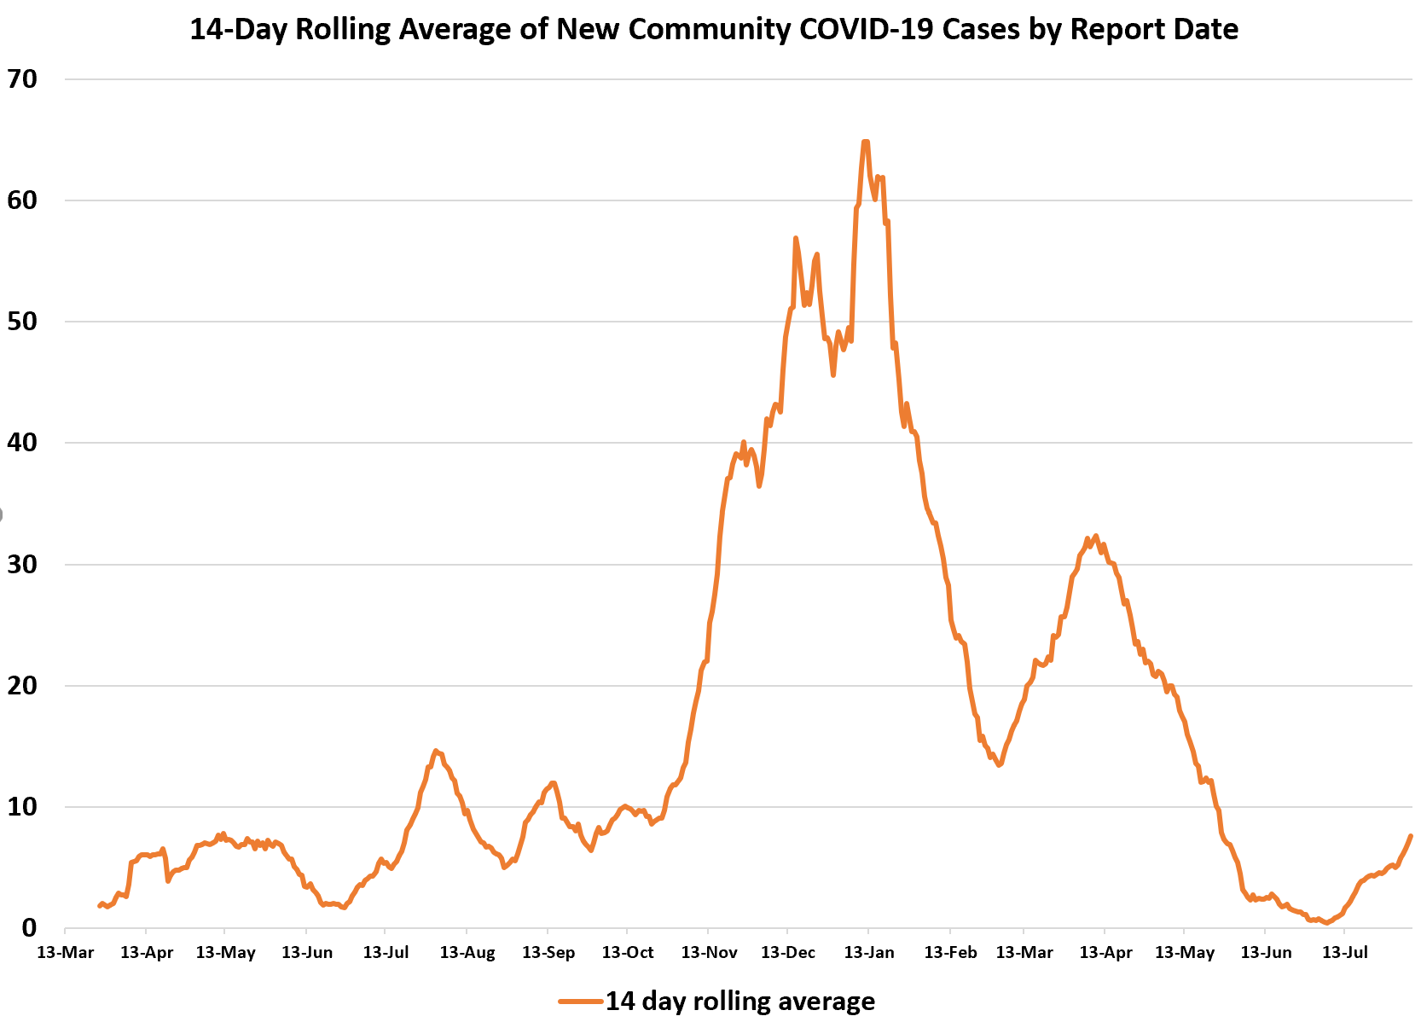
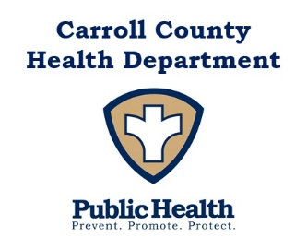
Please note: community cases only

Slide 5
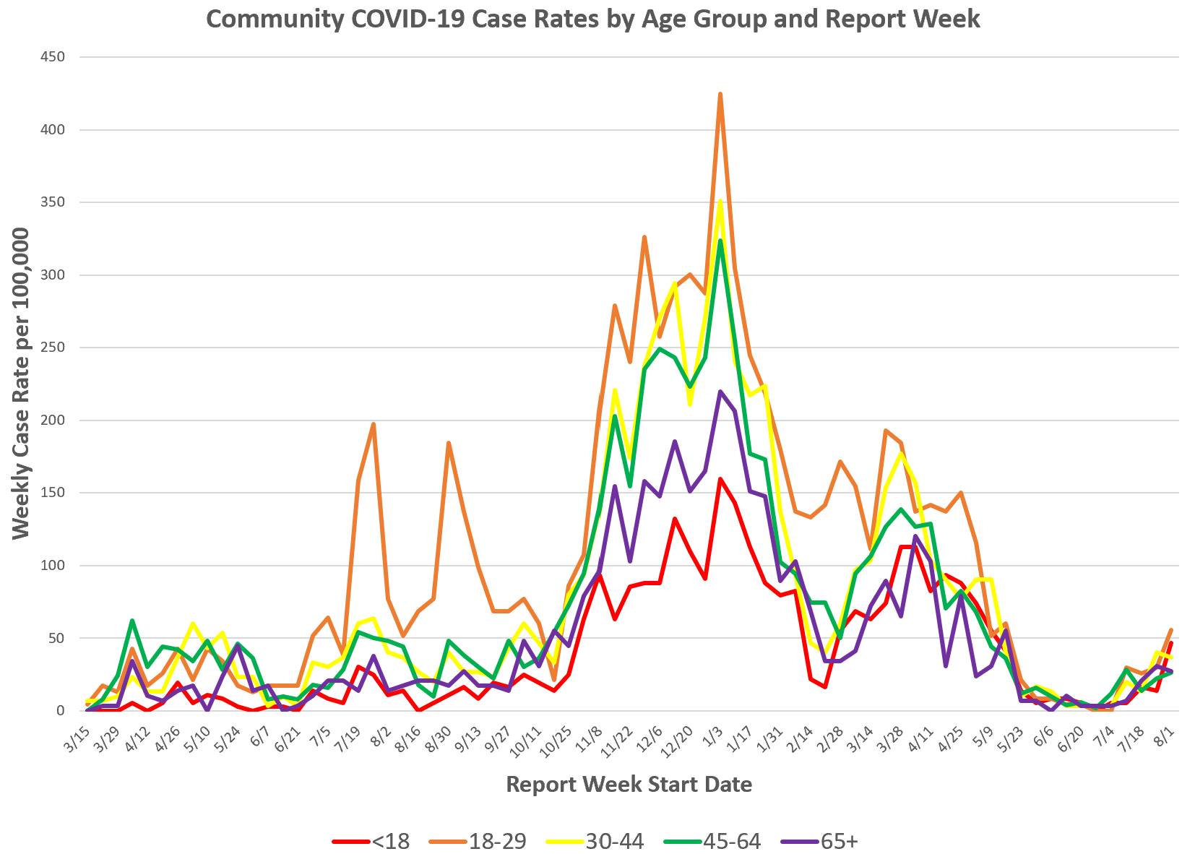
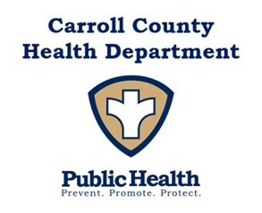
Community cases only

Slide 6
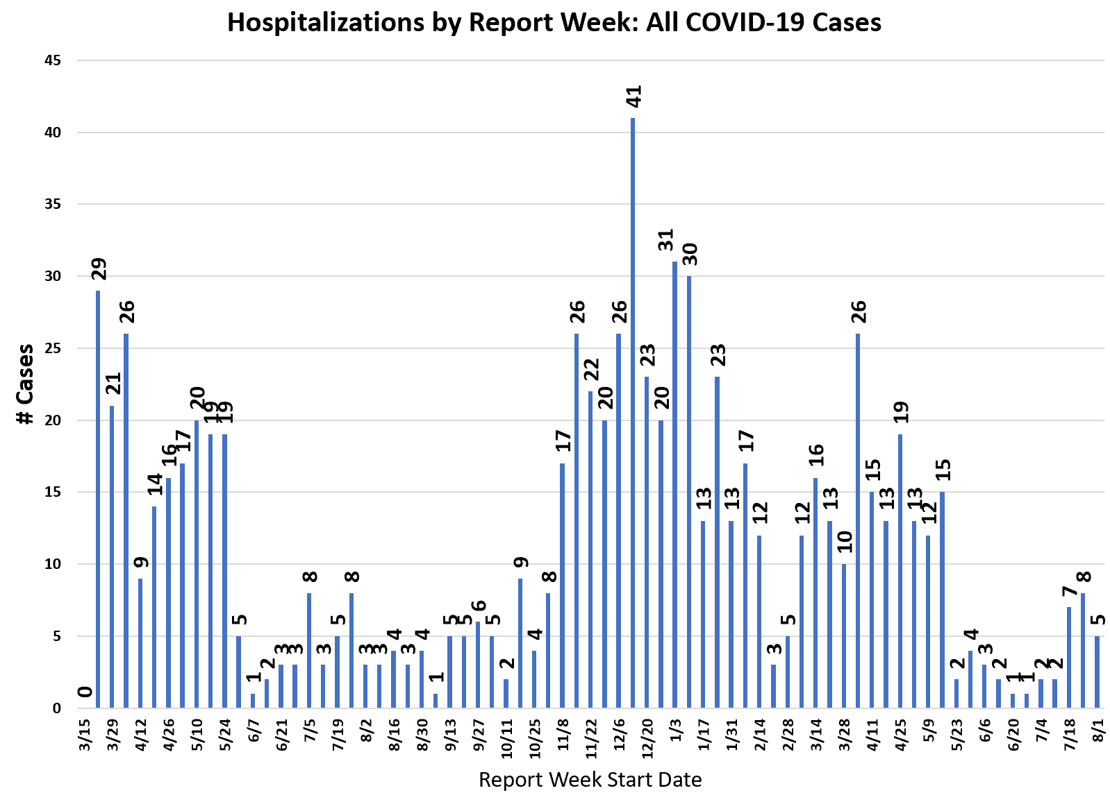
This graph shows hospitalizations by week for COVID positive Carroll County residents, in any hospital.
Report week is the week their case was reported, which may not be the same week they were hospitalized. Only one hospitalization is noted per person.
There is a slight data lag so recent numbers may increase.
Additional hospital data can be found on our website: https://cchd.maryland.gov/carroll-county-md-cases/
Notes:
Notes about hospital here

Slide 7
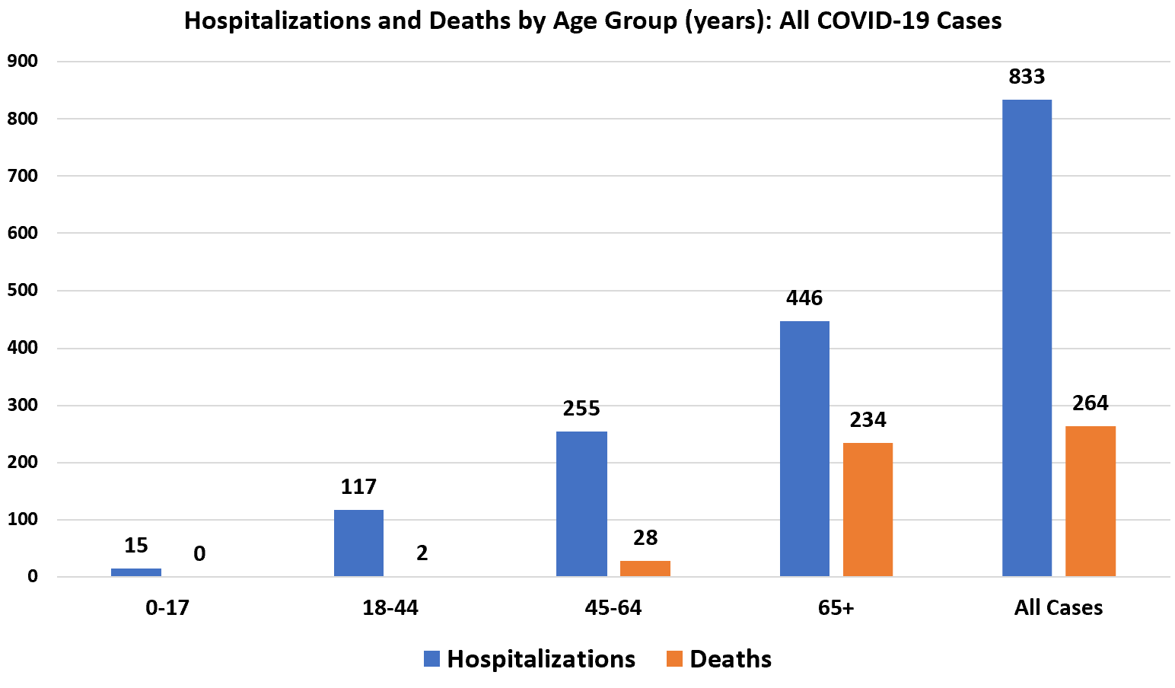

Slide 8
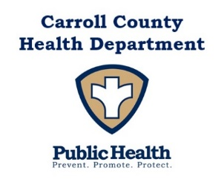
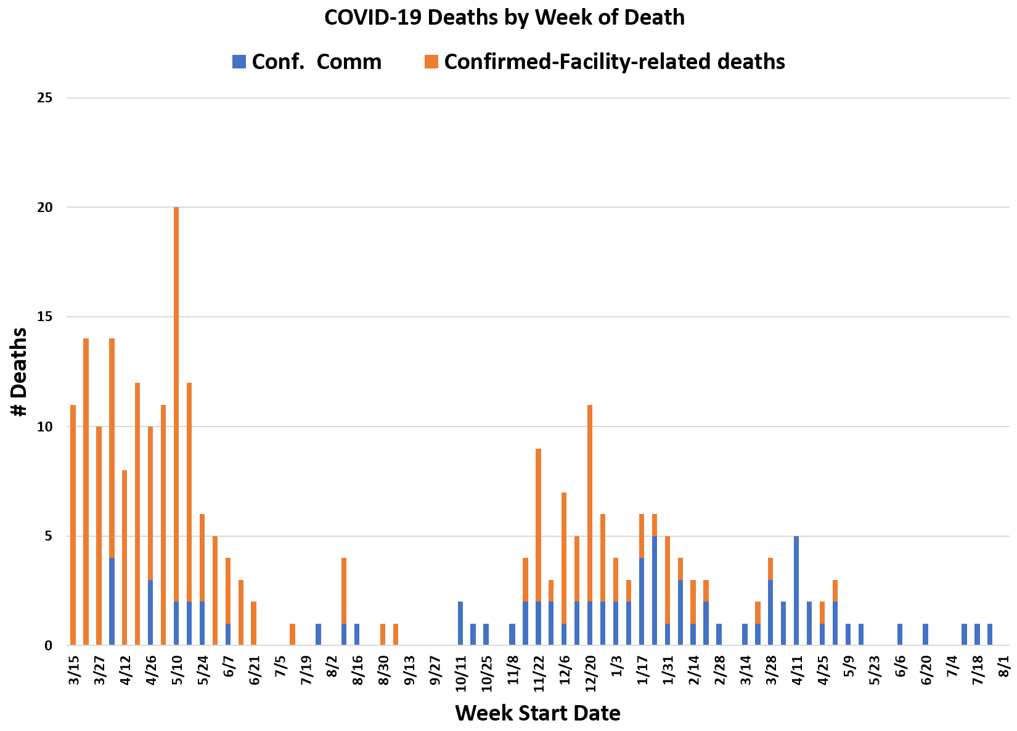
Please note:
This data does not include deaths in probable cases.

Slide 9
New CDC Guidance
Based on data about the Delta variant, which is much more contagious than past versions of the virus and is now causing over 90% of cases in the U.S.
If you are unvaccinated or partially vaccinated, practice all recommended prevention measures until fully vaccinated.
To maximize protection from the Delta variant and prevent possibly spreading it to others, wear a mask indoors in public if you are in an area of substantial or high transmission, even if you are fully vaccinated.
Wearing a mask is most important if you have a weakened immune system or if, because of your age or an underlying medical condition, you are at increased risk for severe disease, or if someone in your household has a weakened immune system, is at increased risk for severe disease, or is unvaccinated. If this applies to you or your household, you might choose to wear a mask regardless of the level of transmission in your area.
CDC recommends universal indoor masking for all teachers, staff, students, and visitors to K-12 schools, regardless of vaccination status. Children should return to full-time in-person learning in the fall with layered prevention strategies in place.

Slide 10
Universal masking will prevent kids from missing school. MDH and MSDE recommend that schools in Maryland follow a CDC policy that grants an exception to quarantine for classroom-based close contacts of a COVID-19 case if: 1) The school was practicing universal and correct mask use, distancing, and ventilation and 2) Both students were correctly using masks during the exposure. This would not apply to cafeteria-based close contacts or other special circumstances. Vaccinated individuals and individuals who have been diagnosed with COVID-19 in the last 3 months currently do not have to quarantine after close contact with someone infected with COVID-19. https://www.cdc.gov/coronavirus/2019-ncov/php/contact-tracing/contact-tracing-plan/appendix.html#contact

Slide 11
Two shared goals:
Preventing COVID-19 transmission
Maximizing in-person education
What policy best meets these shared goals?
Policy | Pros | Cons
Universal mask use | Maximizes in-person education for students Minimizes COVID transmission Reduces spread of other respiratory illness Avoids disclosing vaccination status | Inconvenience of masks Mask litter
Mask use mandated for all staff and students who are not vaccinated | Helps preserve in-person education Lowers the chance of COVID transmission Might encourage vaccination for 12+ | Will need to be proactive to prevent bullying related to masks and vaccination Only school nurses can access vaccination status, so hard to enforce policy Schools will not qualify for quarantine exemption so more students will miss school
Masks required in elementary, optional in middle and high school | Protects children who are not old enough to be vaccinated | Will need to be proactive to prevent bullying related to masks and vaccination Schools will not qualify for quarantine exemption so more students will miss school Higher chance of losing in-person schooling

Slide 12
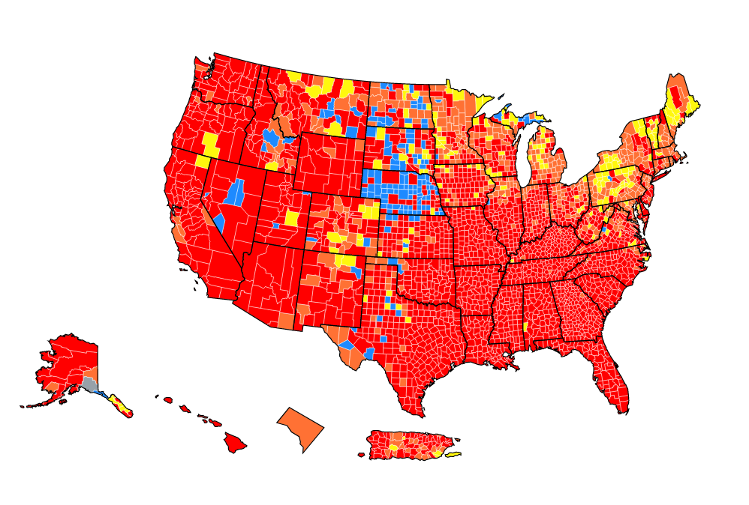
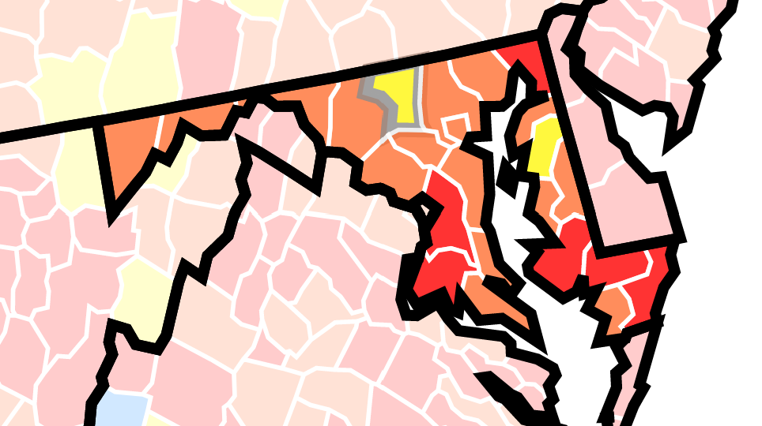
Areas of high (red), substantial (orange), moderate (yellow), and low (blue) transmission of COVID-19
Last week, all of Maryland was at moderate levels, and now 13 jurisdictions are substantial and one is high. Carroll is still moderate.

Slide 13
Covid-19 Vaccine Doses Administered by CCHD*
1st doses administered | 27,289
Single-doses J&J | 562
2nd doses administered | 25,951
TOTAL DOSES ADMINISTERED | 53,802
As of August 10, 2021
Notes:
Pace of vaccination slowing
Need to vaccinate more younger adults

Slide 14
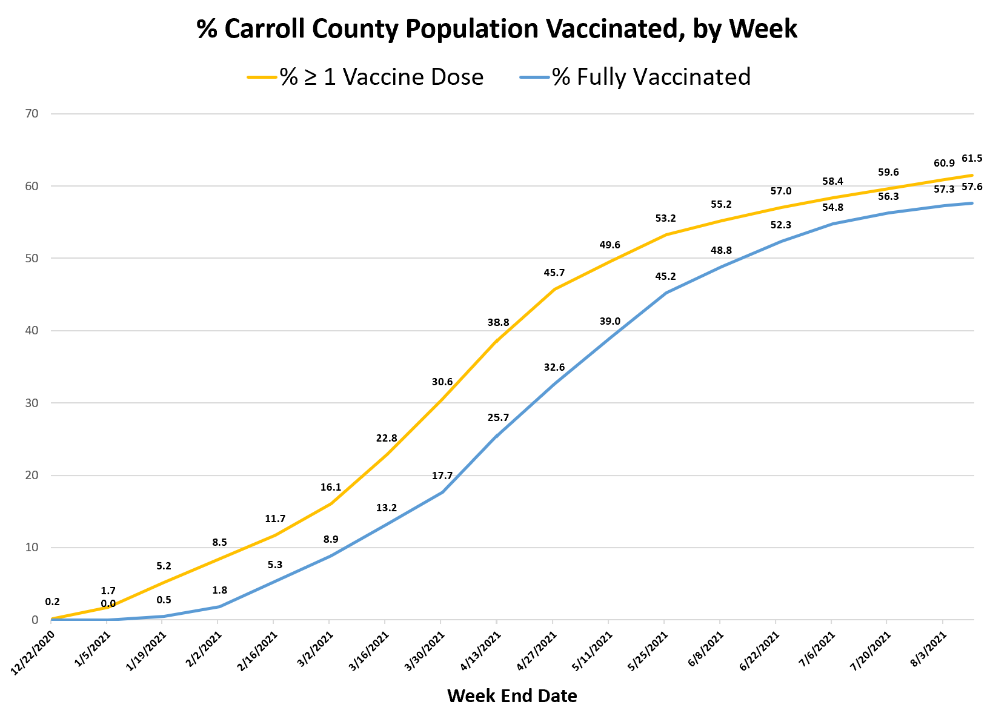
This table shows the percentage of the total population (all ages including children) who are vaccinated.

Slide 15
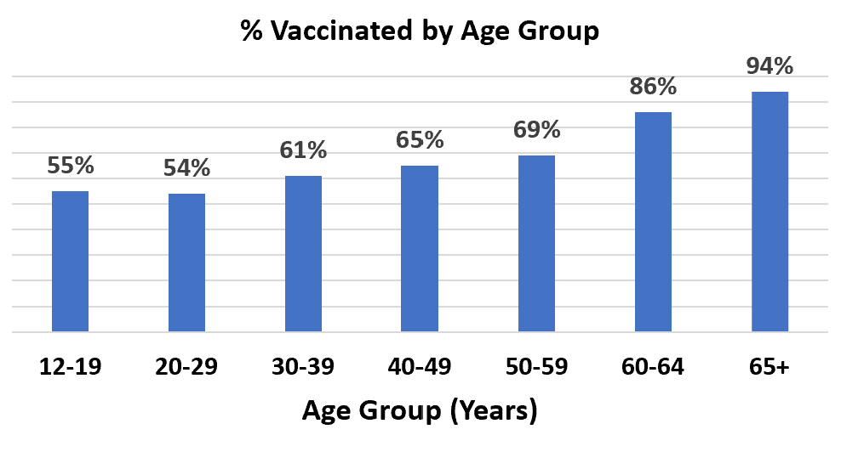

Slide 16
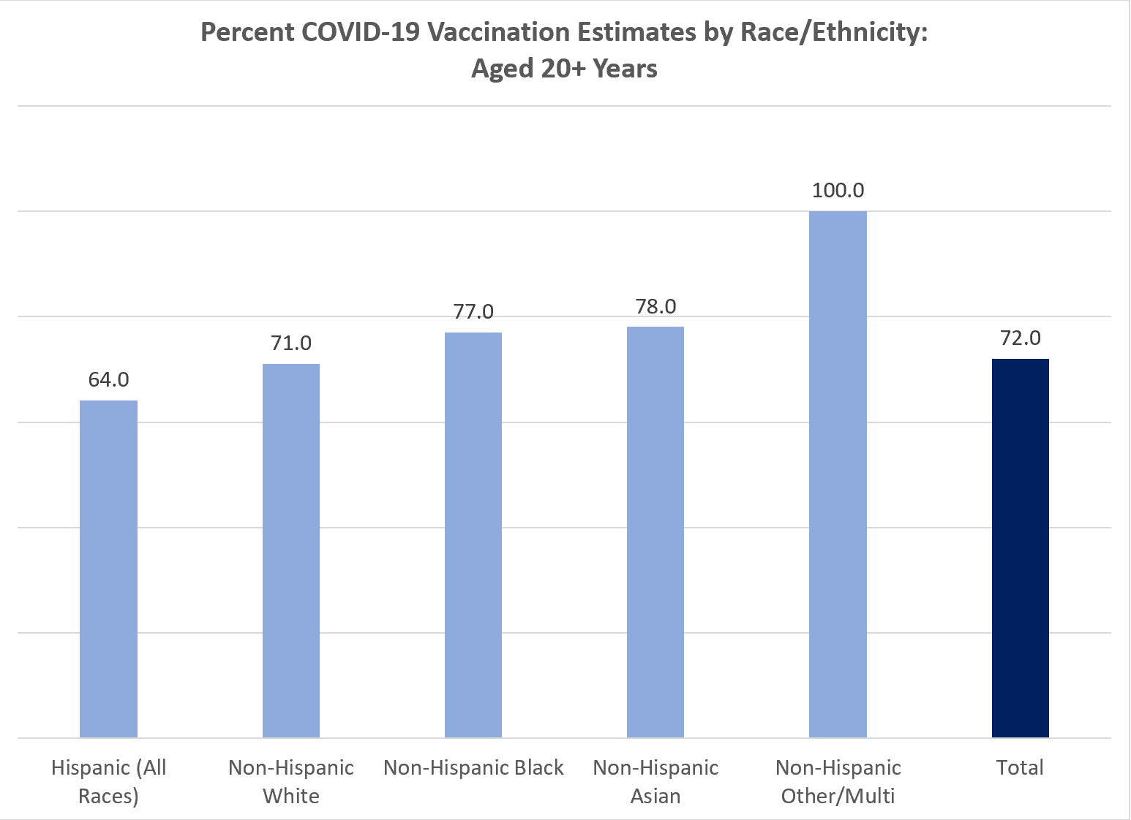

Slide 17
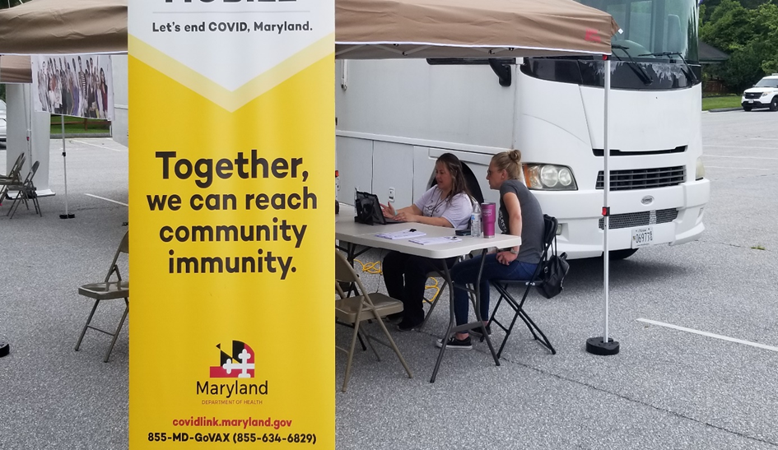
Vaccination Clinics
Come to a Health Department clinic, 290 South Center St., Westminster
Tuesdays 10:00 am to 12:00 pm starting August 10th
Fridays 1:00 to 3:00 pm starting August 6th
Anyone 12 and up can be vaccinated at these clinics (Pfizer is still the only vaccine approved for use in ages 12-17)
All links shared on our website.
https://cchd.maryland.gov/registration-links/

Slide 18
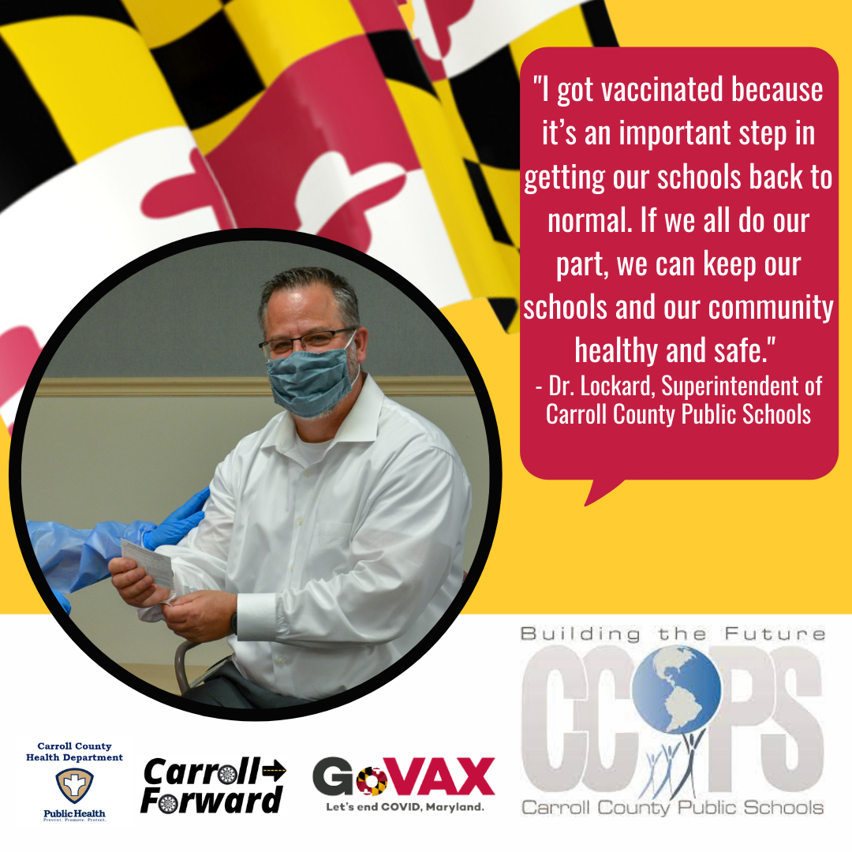
Learn more about COVID-19 vaccinations, including myths and FAQs, at https://cchd.maryland.gov/covid-19-vaccination/

Slide 19
Questions?

